Slide 1


Bennet Hörmann, Salomo Hummel, Simeon Schrape, Erik Wu, Udo Zucker
A web application for analyzing subspace outliers on high dimensional datasets

Slide 2

Outlier
data point that differs significantly from other data points

Slide 3
Outlier
data point that differs significantly from other data points

Slide 4
Why Outlier Detection ?
outliers degrade machine learning methods
analyze big data
can be interpreted as errors or interesting data

Slide 5
Subspace Outliers
data points which are outliers in certain subspaces

Slide 6
Subspace Outliers
data points which are outliers in certain subspaces

Slide 7
Subspace Outliers
data points which are outliers in certain subspaces

Slide 8
Subspace Outliers
data points which are outliers in certain subspaces

Slide 9
Subspace Outliers
data points which are outliers in certain subspaces

Slide 10
Subspace Outliers
data points which are outliers in certain subspaces

Slide 11
Subspace Outliers
data points which are outliers in certain subspaces

Slide 12
Problem

Slide 13
Solution

Slide 14


Slide 18


Slide 19


Slide 21


Slide 22


Slide 26


Slide 27


Slide 29
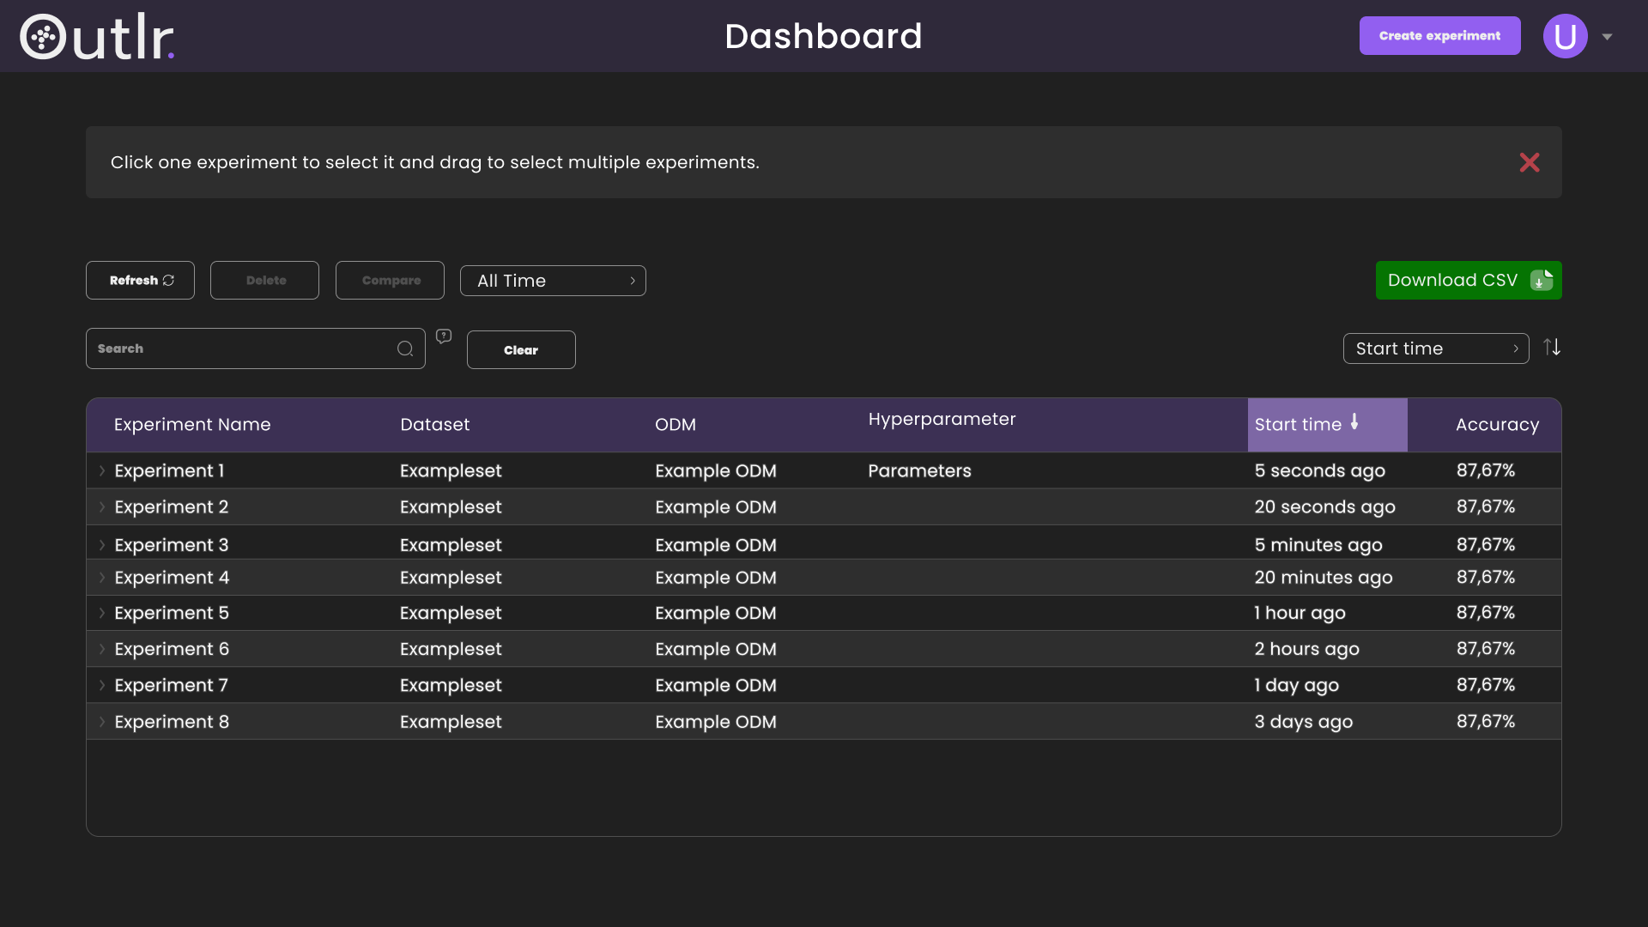


Slide 42


Slide 53
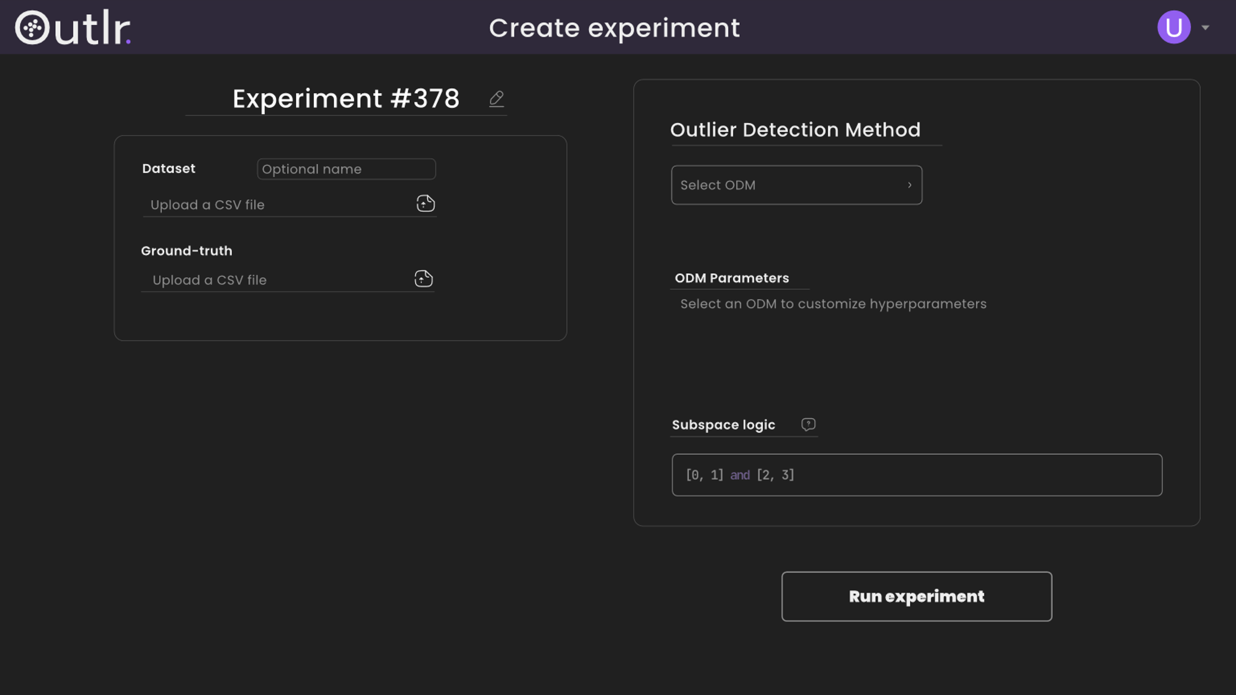

Slide 55
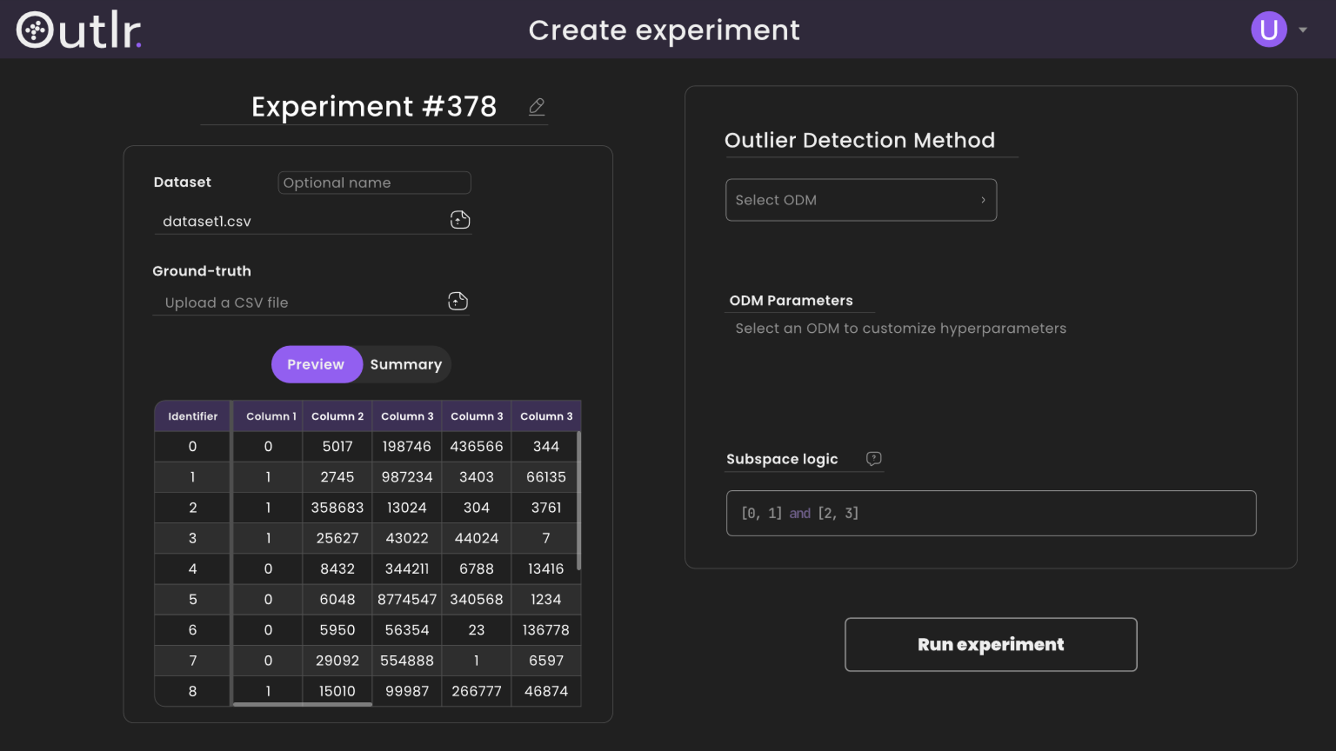

Slide 56
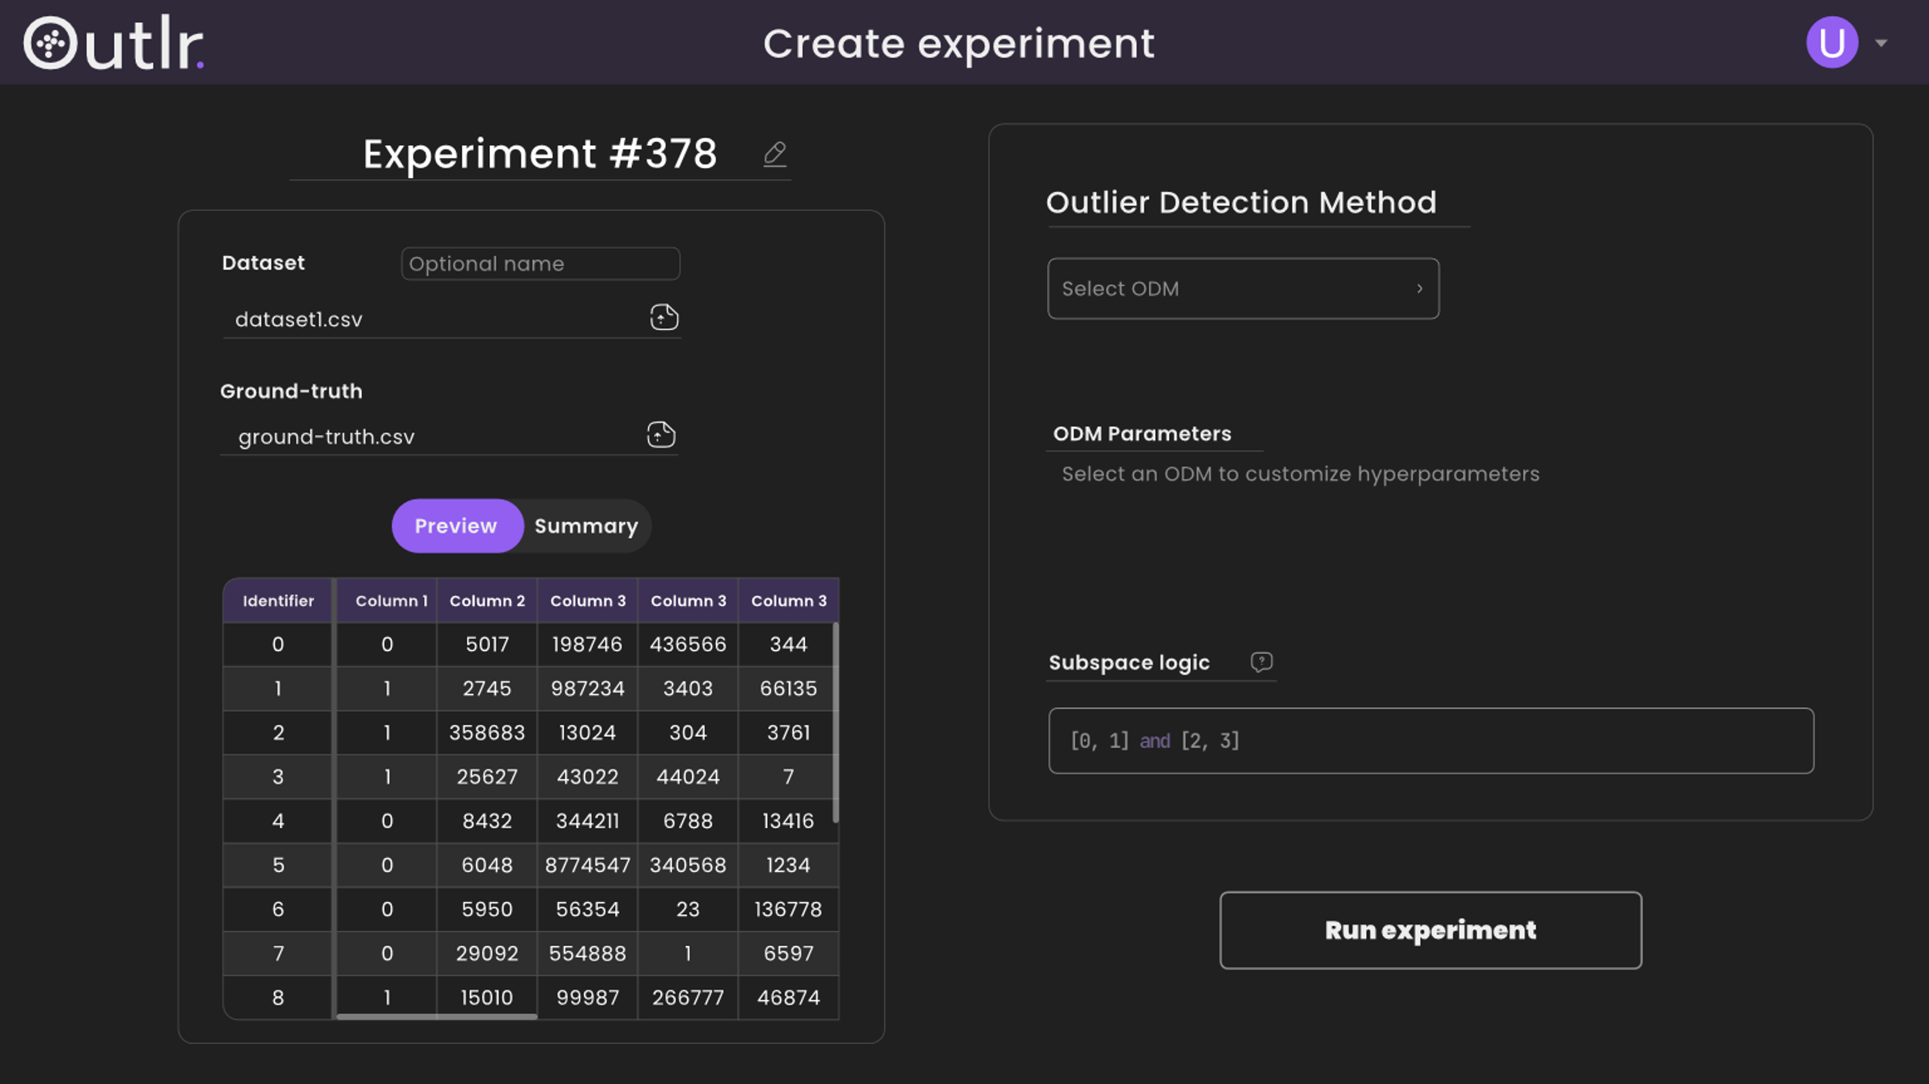

Slide 59
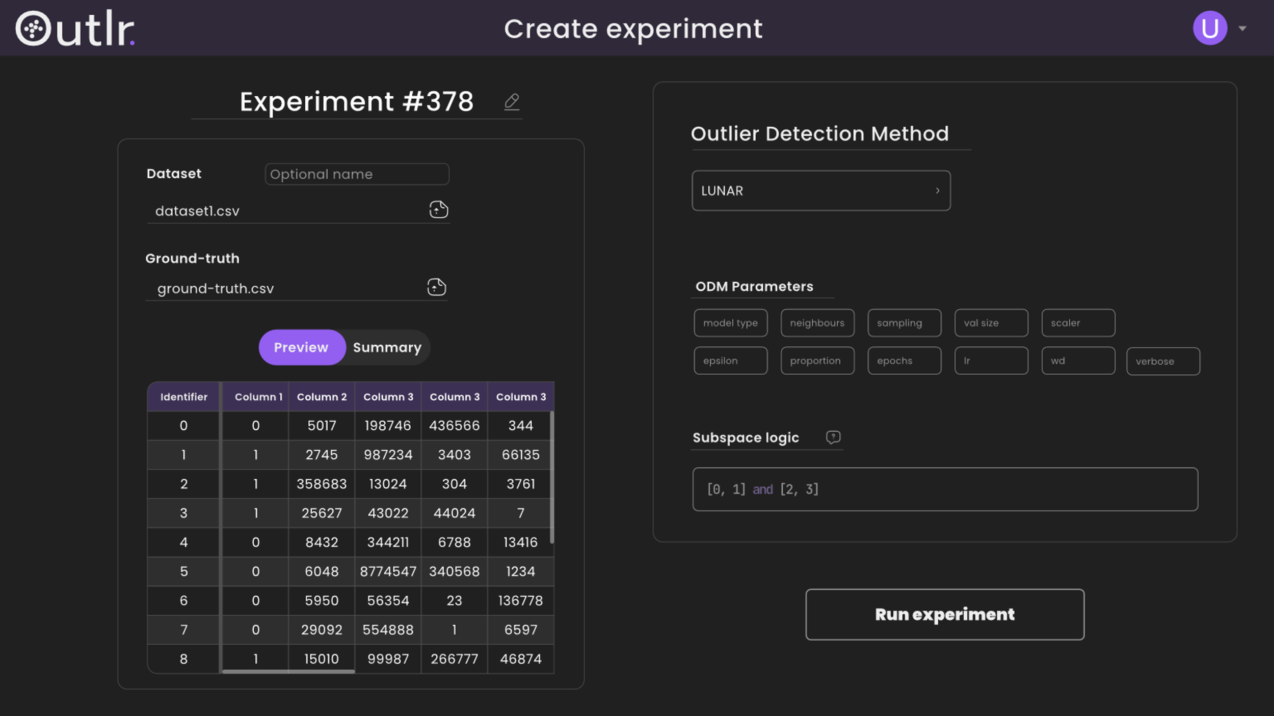

Slide 61
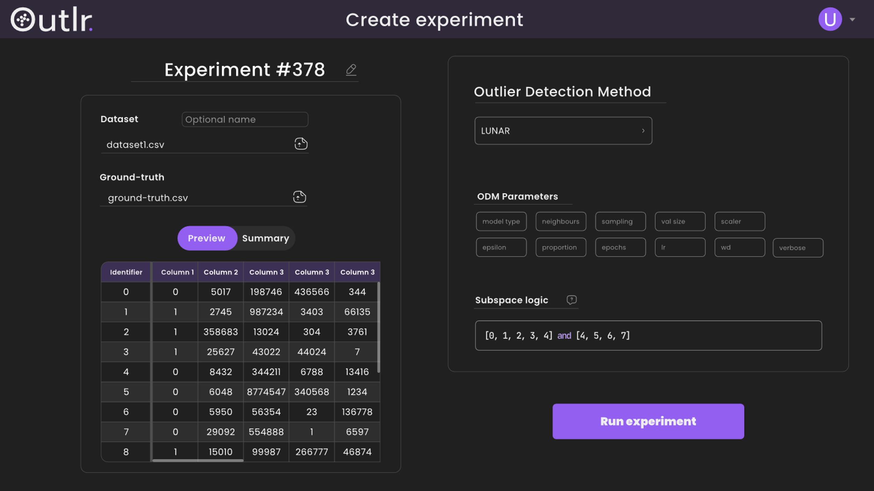

Slide 62


Slide 63


Slide 67
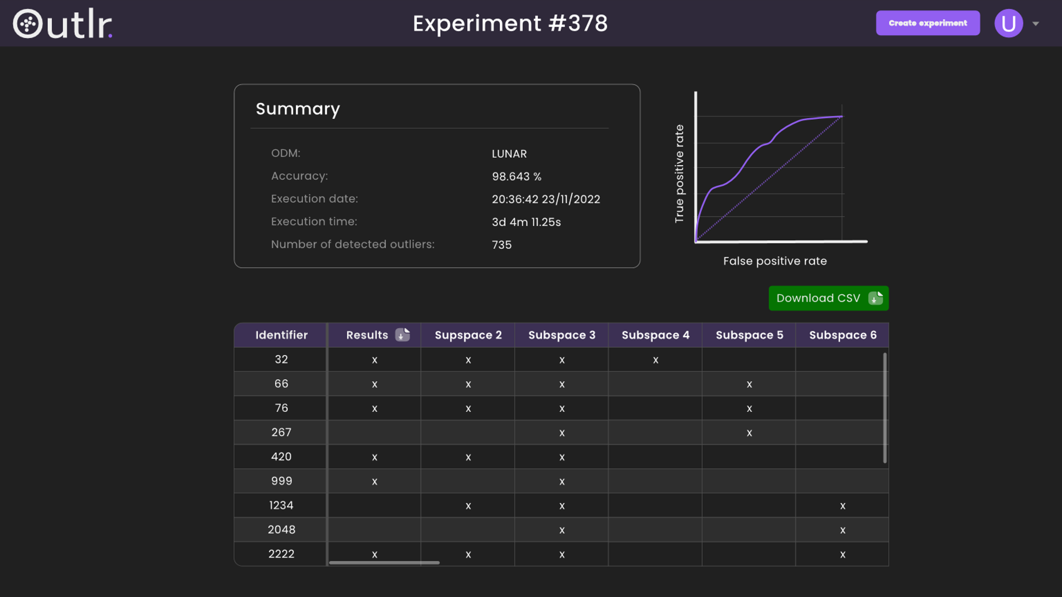

Slide 75

System Architecture

Slide 76
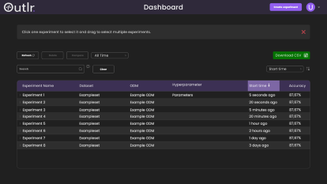

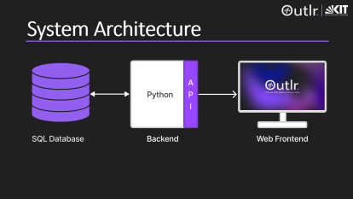
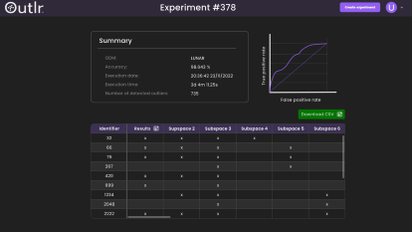

Any Questions ?

